Slide 1
jade
Node template engine

Slide 2
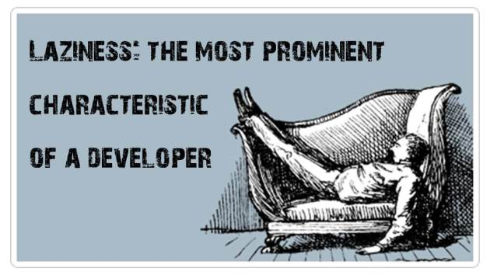

Slide 3
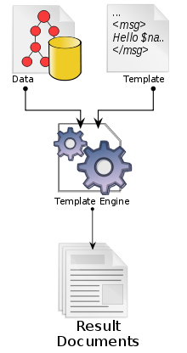
Write code that is interpreted into a syntax that browsers understand
What is Template Engine?
Known also as template processors or parsers

Slide 4


Why ?
Jade is called the “sugar” of HTML
doctype html
html
head
title Nested Tables
body
table
tr
td: a(href='http://jade-lang.com/') Jade
td: table
tr: td: h1 Software
tr: td: h1 University

Slide 5
Why ?
1. It’s cool! And it’s most used templating-engine for Node.js
2. You already know it! It’s easy to write and easy to read.
3. Using variables inside templates and basic logic operations
5. Support includes and extends
5. Universal – works as server-side, as client-side language

Slide 6

$ npm install jade
So... How?
-h, --help output usage information
-V, --version output the version number
-P, --pretty compile pretty html output
-w, --watch watch files for changes and automatically re-render
$ jade index.jade

Slide 7
Jade Syntax
Creating Simple Tags - whitespace sensitive, no need to close your tags
div
address
i
strong
<div>
<address></address><i></i><strong></strong>
</div>
Putting Text Inside your Tags - three ways to put plain text inside a tag
h1 Welcome to Jade
p
| Text can be included in a number of
| different ways.
p.
This way is shortest if you need big
blocks of text spanning multiple
lines.
<h1>Welcome to Jade</h1>
<p>
Text can be included in a number of
different ways.
</p>
<p>
This way is shortest if you need big
blocks of text spanning multiple
lines.
</p>

Slide 8

Jade Syntax
Adding Attributes to your Tags, IDs & Classes
table#sub
tr.up: td Be Awesome!
tr.down: td Now!
<table id="sub">
<tr class=“up">
<td>Be Awesome</td>
</tr>
<tr class=“down">
<td>Now!</td>
</tr>
</table>

Slide 9
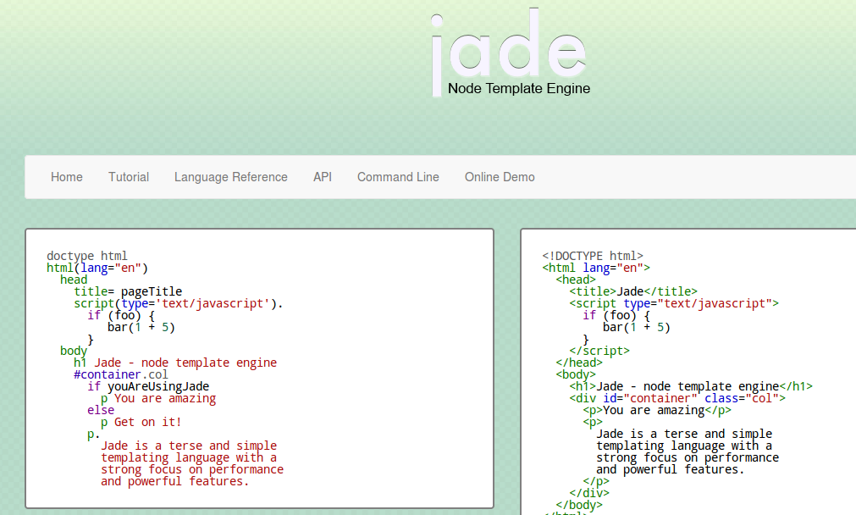
Jade Syntax
And even MORE!
LIVE DEMO
http://jade-lang.com
http://html2jade.org/

Slide 10
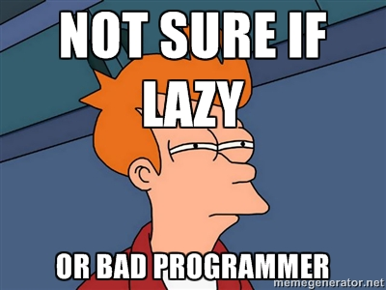
Summary
So… We learned why Jade is making your life easier, HTML more interesting and programming more sweet :}

Slide 11

“Simple things should be simple, complex things should be possible” -Alan Kay
questions
Any ?:

